Slide 1
Vietnam
19 December 1946 - 1 August 1954
1 November 1955 – 30 April 1975
2 July 1976 - Present
David J. Pristash
In Country 1967
Back in the World 1968

Slide 2
Main Discussion Points
What is Vietnam?
Why was there a war?
The American Involvement
Why did the war turn out bad?
Why was the war forgotten?

Slide 3
What is Vietnam ?
Under China from 111 BC to 939 AD
Independent from 939 to 1878
French rule from 1878 to 1954
Two Vietnams from 1955 to 1975
  US Advisors 1954 to 1964
  US Combat 1964 to 1973
  US support to the South ended in 1974
  The South fell to the North 8 months later in 1975
One Vietnam from 1976 to Present

Slide 4
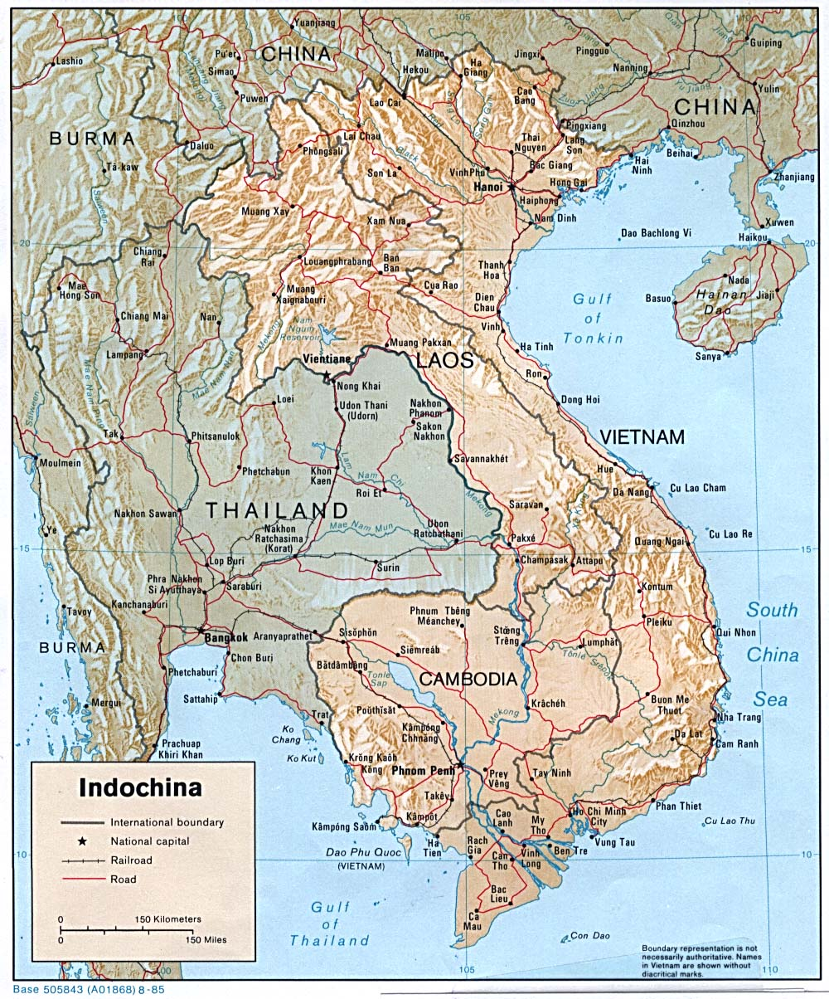




Indochina
Indo-Chinese Federation
1878 - 1954

Slide 5
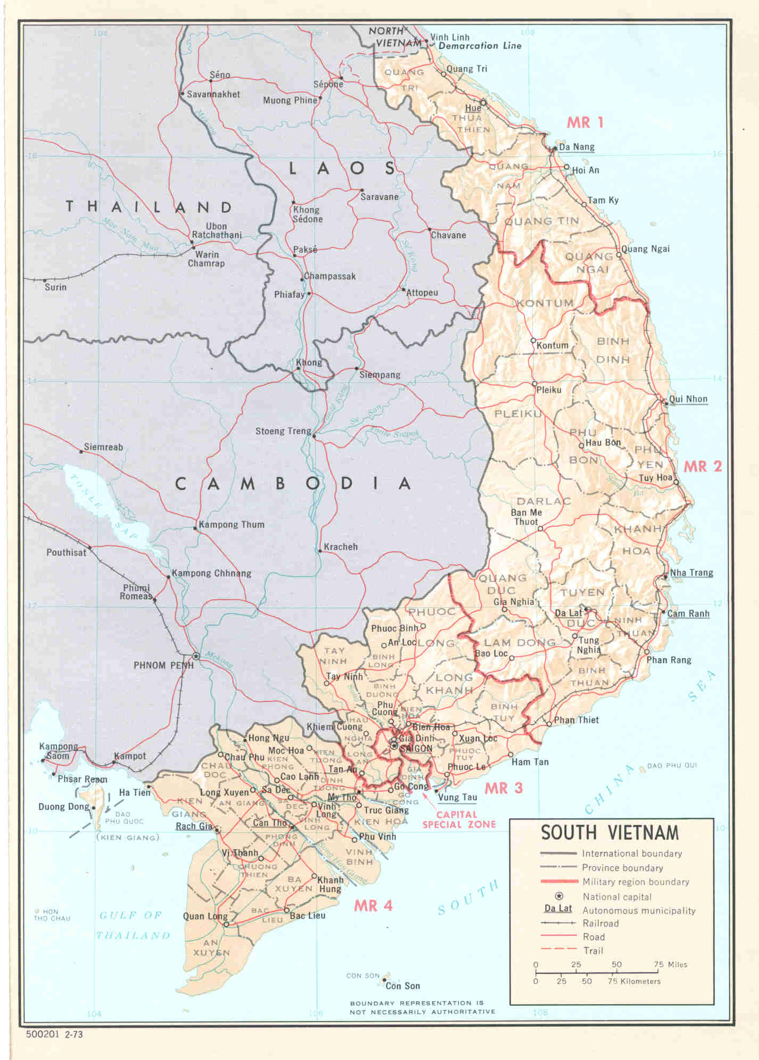
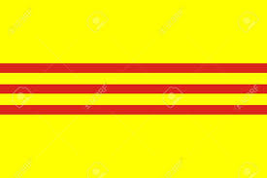
Republic of South Vietnam
RVN
1955 to 1975

Slide 6

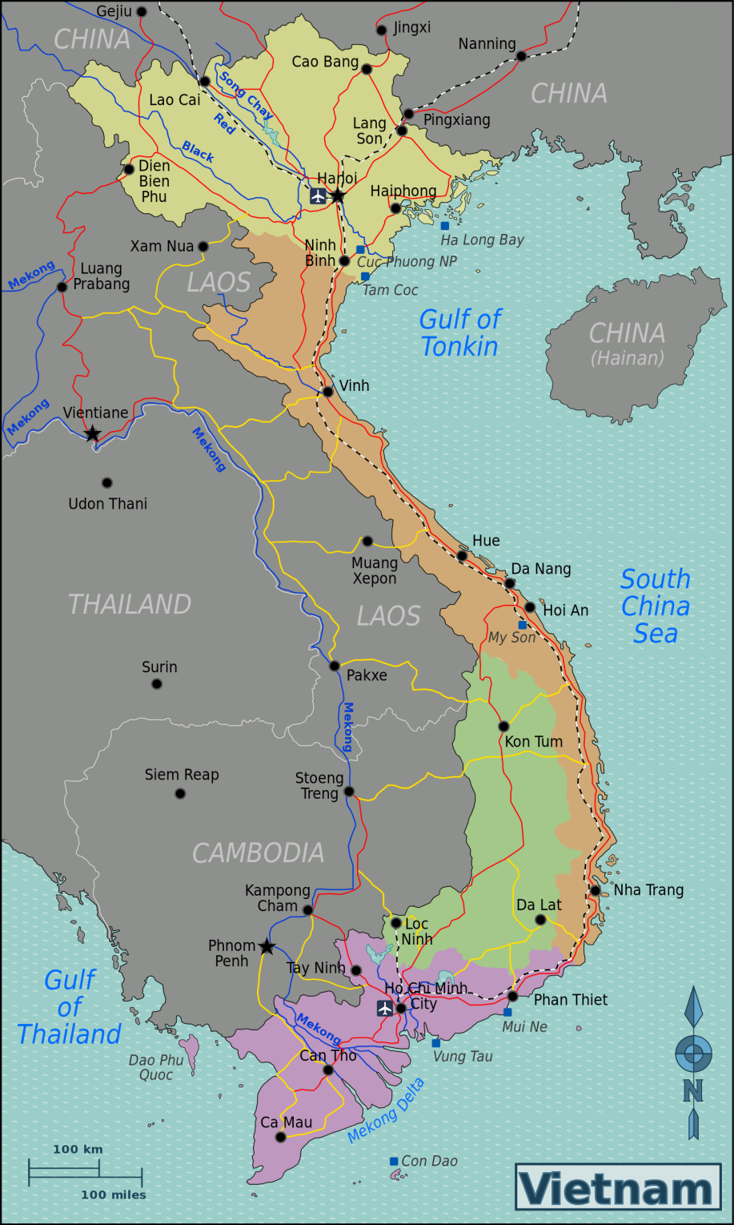
Socialist Republic of Vietnam
1975 to present

Slide 7
Why was there a war, History
From about 1870 to 1930 two “NEW” forms of federal government developed
Under America we had limited federal government
  Free Market Capitalism
  Citizens free to make their own way
Under Europe and Asia were countries with very powerful federal governments
  Communalism or Socialism and Fascism
  Citizens that had limited freedom

Slide 8
Why was there a war, History
All the forces of change came together in a world wide conflict which became known as WW II which lasted from 1939 to 1945 and two teams formed to fight each other
Team One the Axis was the Empire (dark side)
  Germany, Japan and Italy
Team Two the Allies was the Republic (the force)
  America, Great Briton, Russia and China

Slide 9
The Draft
The United States needed a military prior to the start of World War II
During the presidency of Franklin Delano Roosevelt (FDR) a law was passed on 16 September 1940 that all able bodied men over 18 and under 35 had to register for the draft
The war was very bad and waged across the entire world
  24,000,000 or more soldiers died
  49,000,000 or more civilians died

Slide 10
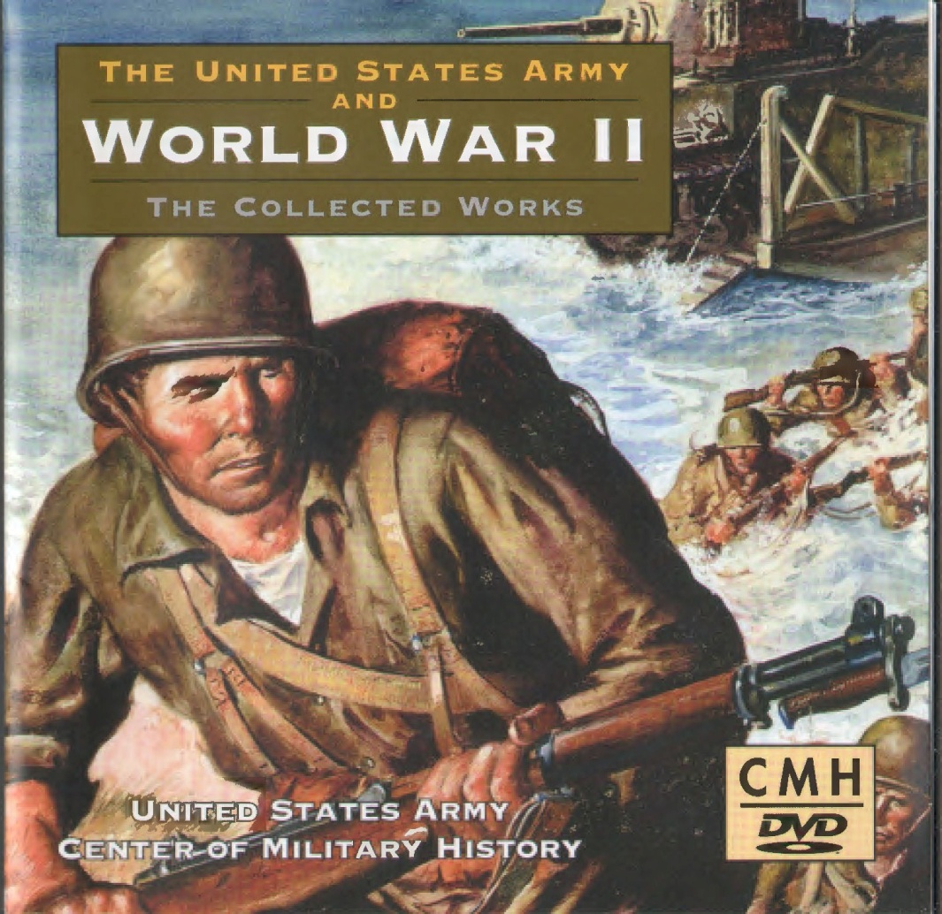
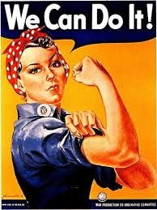
Everyone was involved in WW II

Slide 11
The end of World War II
After the end of World War II and after Team Two won, the world became divided again between these two very different views of government but in a different alignment
Each view had its champion
  Team USA was for having Free people
  Team Russia (U.S.S.R.) was for controlling the people
The conflict between the two would go on for the next 45 years
  The Vietnam War was “only" one of those conflicts

Slide 12
Why was there a war, History
The American people being free were tired of war and wanted to be left alone
In Russia (USSR) the people were not free and their government wanted to take over the entire world and make them communists
This conflict was called the Cold War
And the expansion of Team Russia into many countries was called the Domino Effect (Theory)
And a new kind of warrior was needed to fight this kind of war and they were the best of the best and were to be known as the Green Beret’s

Slide 13

Break for Questions

Slide 14
The 1st Indochina war 1946 to 1954
After WW II ended the French were allowed to reoccupy their former colony - Indochina
The Vietnamese people who had fought with Team Two (US) against the Japanese (part of Team One) were not happy with this. They assumed that the US would not allow the French to come back
In hind sight this was a major mistake!

Slide 15
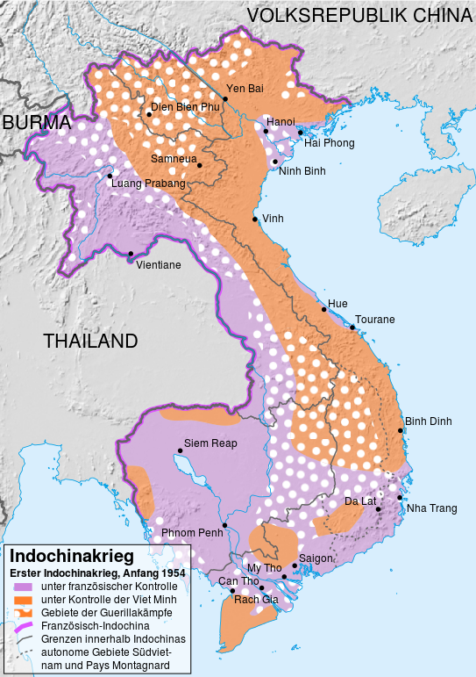
The 1st Indochina war 1946 to 1954
  The Vietnamese under the leadership of Hồ Chí Minh, a Communist, resisted the French taking over their country again
  The Vet Minh under General Võ Nguyên Giáp defeated the French at Dien Bien Phu in the mountains on 7 May 1954 with much help from the Chinese Communists

Slide 16
The 1st Indochina war 1946 to 1954
7 May 1954 the French are defeated and leave Vietnam and Indochina
21 July 1954 The Geneva Accords temporarily partitioned Vietnam at the 17th parallel with unification elections to be held in 1956.
  The North (communist) supported by Team Russia (U.S.S.R.) and the Peoples Republic of China set up in Hanoi with their picked leader Hồ Chí Minh
  The South (non-communist) mostly Catholics and Buddhists supported by Team USA and Europe set up in Saigon with their picked leader Ngo Dinh Diem
The Elections never happened and the second Vietnamese war started

Slide 17
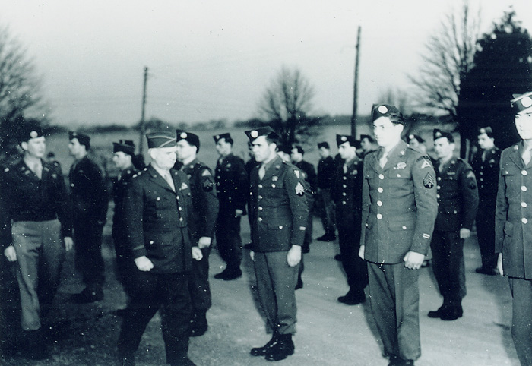
Formation of Special Forces in May 1952 under Colonel Aaron Bank as the first commander

Slide 18
John F Kennedy authorizes the use of the Green Beret on October 12, 1961
My friend Anastas Tasseff
(Ernie)

Slide 19
The Baby Boomer Generation
After WW II ended there was a pent up relief after the Great Depression and WW II and family's decided to have kids again.
Between the end of the war and the assassination of President Kennedy there were between 75.8 and 81.6 million babies born a record never equaled
The those born in 1945 were entering college in 1963 and were the ones that started the protests. By 1967 the colleges were 100% Baby Boomers
Many, but not all, of the Baby boomers were spoiled by their parents and became self centered thinking only about themselves hence they were also known as the “Me Generation”

Slide 20
Break for Questions

Slide 21
The 2nd Indochina War 1954 to 1964
Under Presidents Eisenhower and Kennedy US military advisors and money was sent to the South, the Republic of Vietnam (RVN)
The reason was the Domino Theory
  This belief was held by the political leaders of America and explained why Team Russia was at that time expanding so quickly
  The theory was that as one country fell the next one that boarded it would also soon fall.
  It was feared that most of Asia would soon be under Team Russia if not stopped

Slide 22
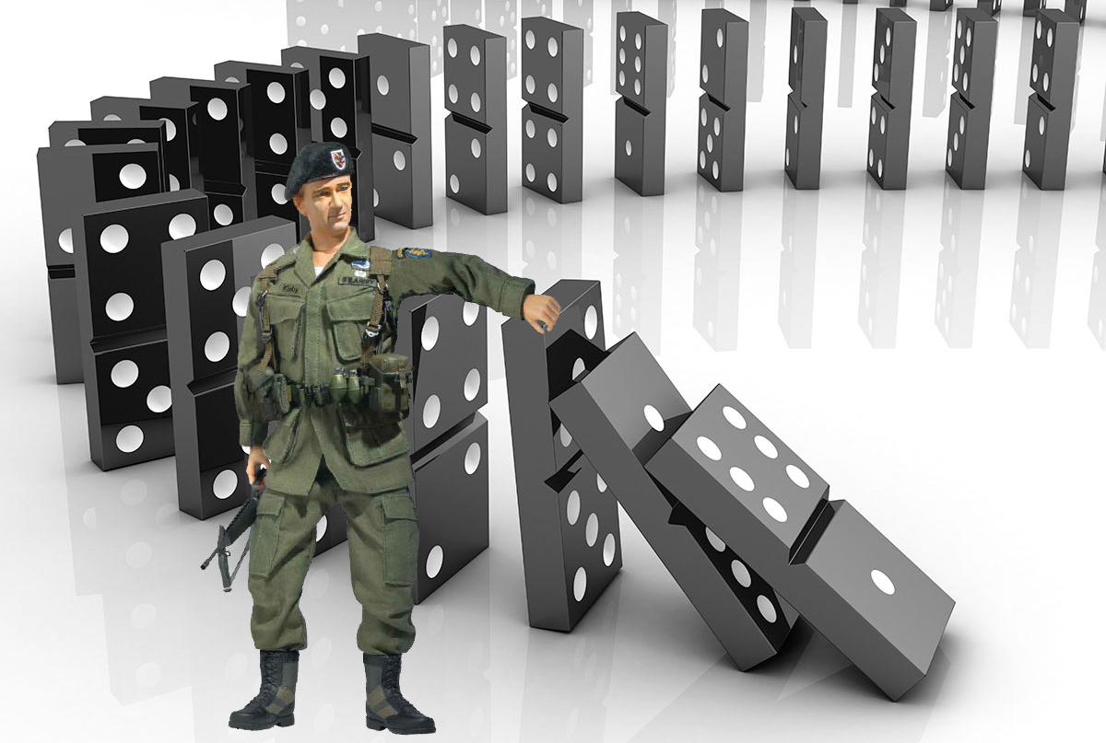
The Domino Effect
Special Forces Stopping the fall of the Dominos

Slide 23
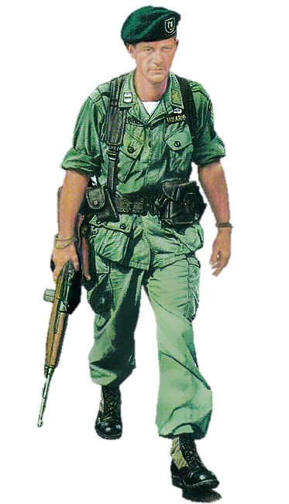
US Advisors 1954 to 1964
US Army Special Forces Green Berets
Advisors to the RVN mostly for training the Vietnamese
From 1954 though 1964 there were a total of 435 military deaths in Vietnam most but certainly not all of them were from the 5th Special Forces Group (Airborne)

Slide 24
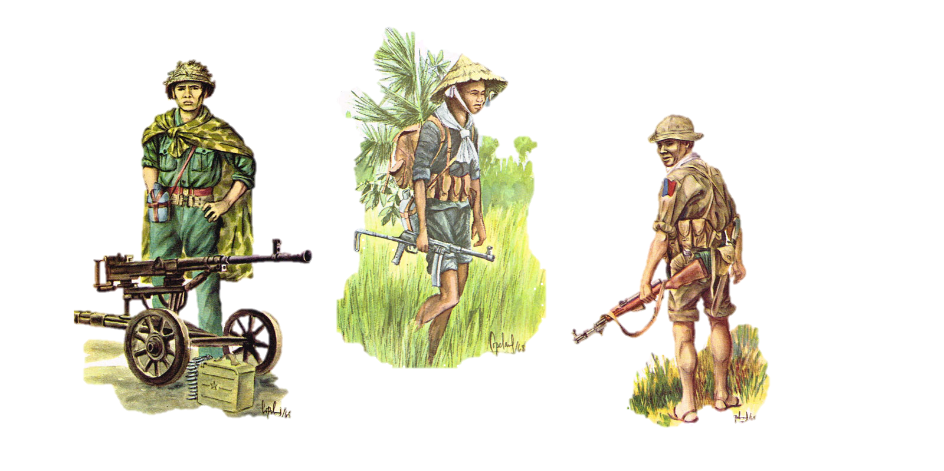
These are the Vietnamese we were fighting
Vet Cong
NVA

Slide 25
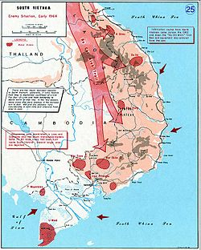
US Advisors 1954 to 1964
Through 1964 few in the US knew much about Vietnam
Times were very good everyone had good jobs or was in college
Happy Days - sitcom
American Graffiti - movie
But the conflict in Vietnam was heating up as the North was Sending troops and supplies to the south on what was known as the Hồ Chí Minh trail

Slide 26
US Advisors 1954 to 1964
The draft during Vietnam
  By the end of the war a total of 2,709,918 American military served in Vietnam
  Up to 1964 most of those in Vietnam were professional or Regular Army (RA)
  After 1964 more and more were drafted (US) such that by the end of the war 648,500 or 25% of those that served in Vietnam had been drafted
  At the end of 1964 there were only 23,310 military troops (Advisors) in Vietnam and only 236 were killed that year

Slide 27
Break for Questions

Slide 28
US Combat 1964 to 1973
During August 2nd and 4th of 1964 an incident happened in the Gulf of Tonkin where it was claimed that US War Ships were fired at
Then President Johnson (LBJ), for reasons yet unknown, asked congress for support to go to war and it was granted on August 10th
At this point the US found itself in a proxy war with Team Russia and a new player Team China who were both supporting the North and their Proxy in the south the Viet Cong

Slide 29
US Combat 1964 to 1973
On 13 February 1965 LBJ authorized an air assault on North Vietnam called Rolling Thunder
On 8 March 1965 the first elements of the Marines were in Vietnam at Da Nang
On 18 April 1965 the “Baby Boomers” started the first protests about the war (and the draft)
On 5 May 1965 the 173rd Airborne Brigade arrived in Biên Hòa
We were now in a real ground war in Asia
By the end of 1965 there were 184,314 American troops in Vietnam and 1,928 more had been killed

Slide 30
US Combat 1964 to 1973
In June of 1965 I graduated from Ohio University and almost immediately got my Draft notice
After taking the pre induction physicals and tests the recruiting sergeant said I would make a good officer and he got me to enlist in the army and in return they would guarantee me that I would go to Officers Candidate School (OCS) at Ft Benning Georgia.
Before I went in I meet a nice young lady who was a teacher and who would become my wife

Slide 31
US Combat 1964 to 1973
I flew to Ft Benning Georgia (first time on an airplane) for basic training in November 1965
I finished basic took leave to Cleveland asked Darlene Ann Fill to marry me and she said yes.
I was rushed though all the training ( I was in very good shape so it wasn’t hard)
By the end of the 1966 I was a 2nd Lieutenant, Airborne qualified (Jump out of perfectly good airplanes) a Green Beret at Ft Bragg and married
By the end of 1966 there were 385,300 American troops in Vietnam and 6,143 more had been killed Protests to the war were up now and being noticed

Slide 32
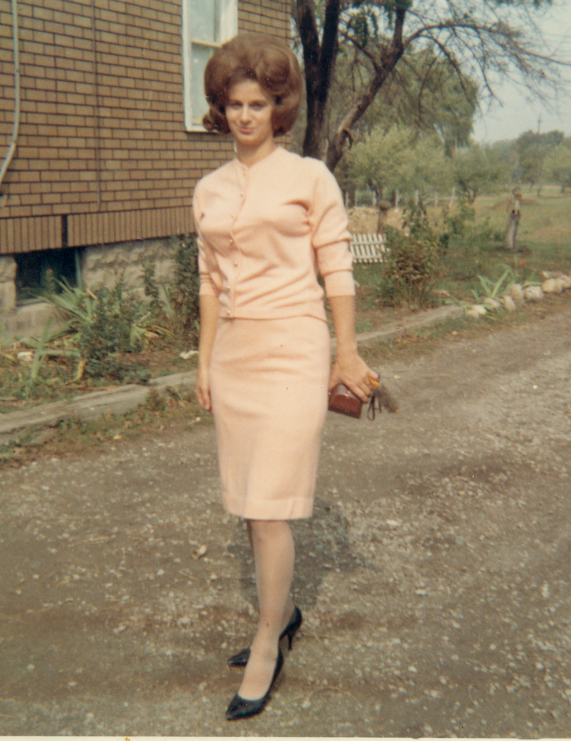
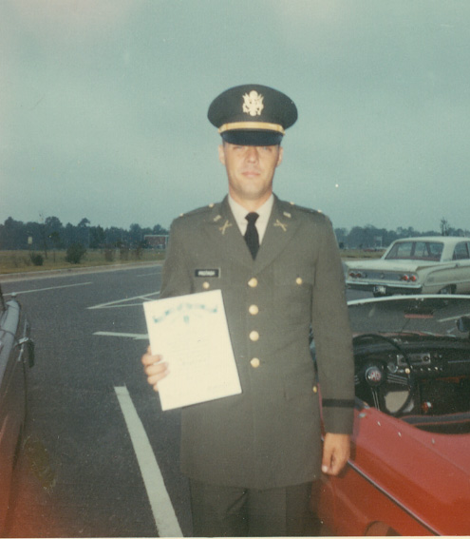
Darlene and I in 1966

Slide 33
Ft Bragg North Carolina 1967
During most of 1967 I was in training for Vietnam including language school.
During the summer John Wayne was making the Movie “The Green Beret” and I was selected to help make the movie.
Fifteen of us flew to Elgin Airforce base in Florida where we did a night parachute jump for the movie from an old WW II C– 47 Military transport airplane
The part that I was filmed in wasn’t used in the movie but I did get to meet John Wayne.

Slide 34
Ft Bragg North Carolina 1967

Slide 35
My Time in Vietnam
The buildup continued and although we won most of the battles we were not wining the war
I shipped out for Vietnam and arrived in Na Trang after a long flight at the 5th Special Forces Group headquarters in September 1967
I was assigned to A-Company in Biên Hòa near Saigon then to B-34 at Song Ba and lastly as the Executive Officer (XO) of the 5th Special Forces Group Airborne CIDG camp A-341 Bu Dop in Phuoc Long Province

Slide 36
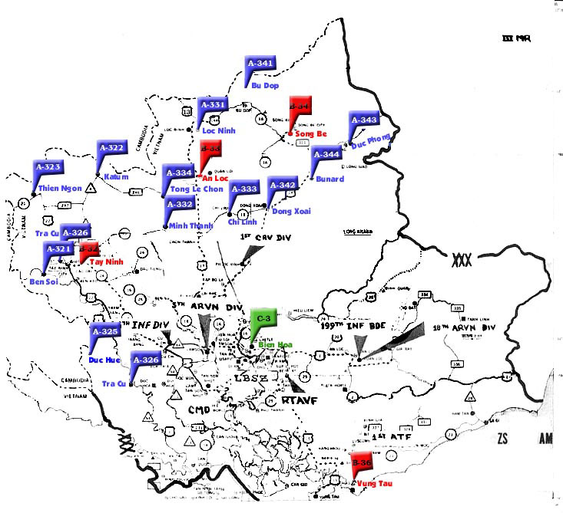
III Corps Tactical Zone
Cambodia
Bu Dop A-341
Saigon now
Ho Chi Minh City

Slide 37
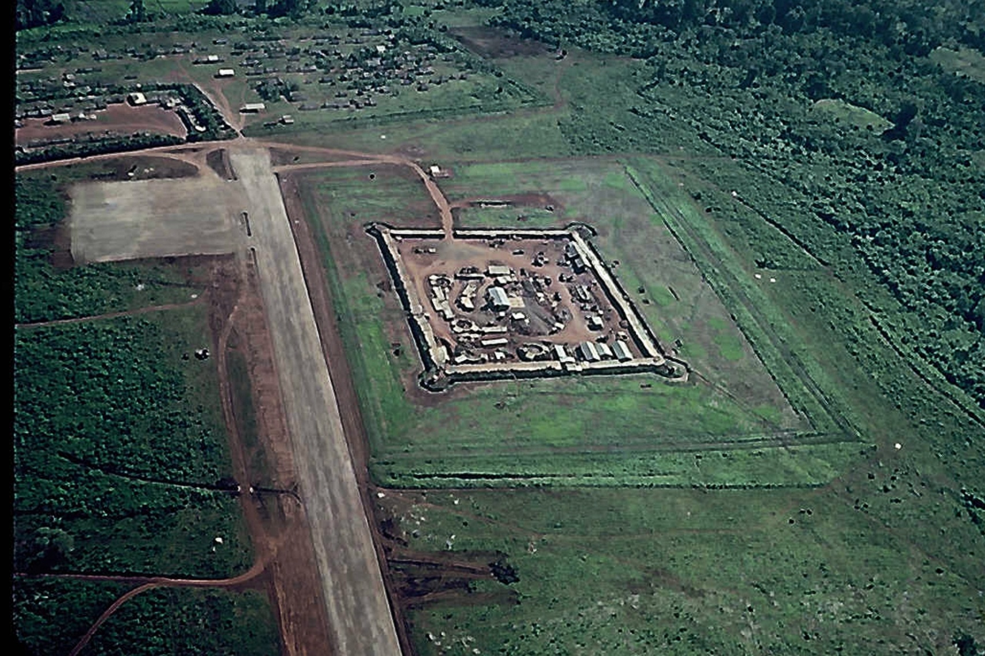
Bu Dop A-341
Picture Paul Posey

Slide 38
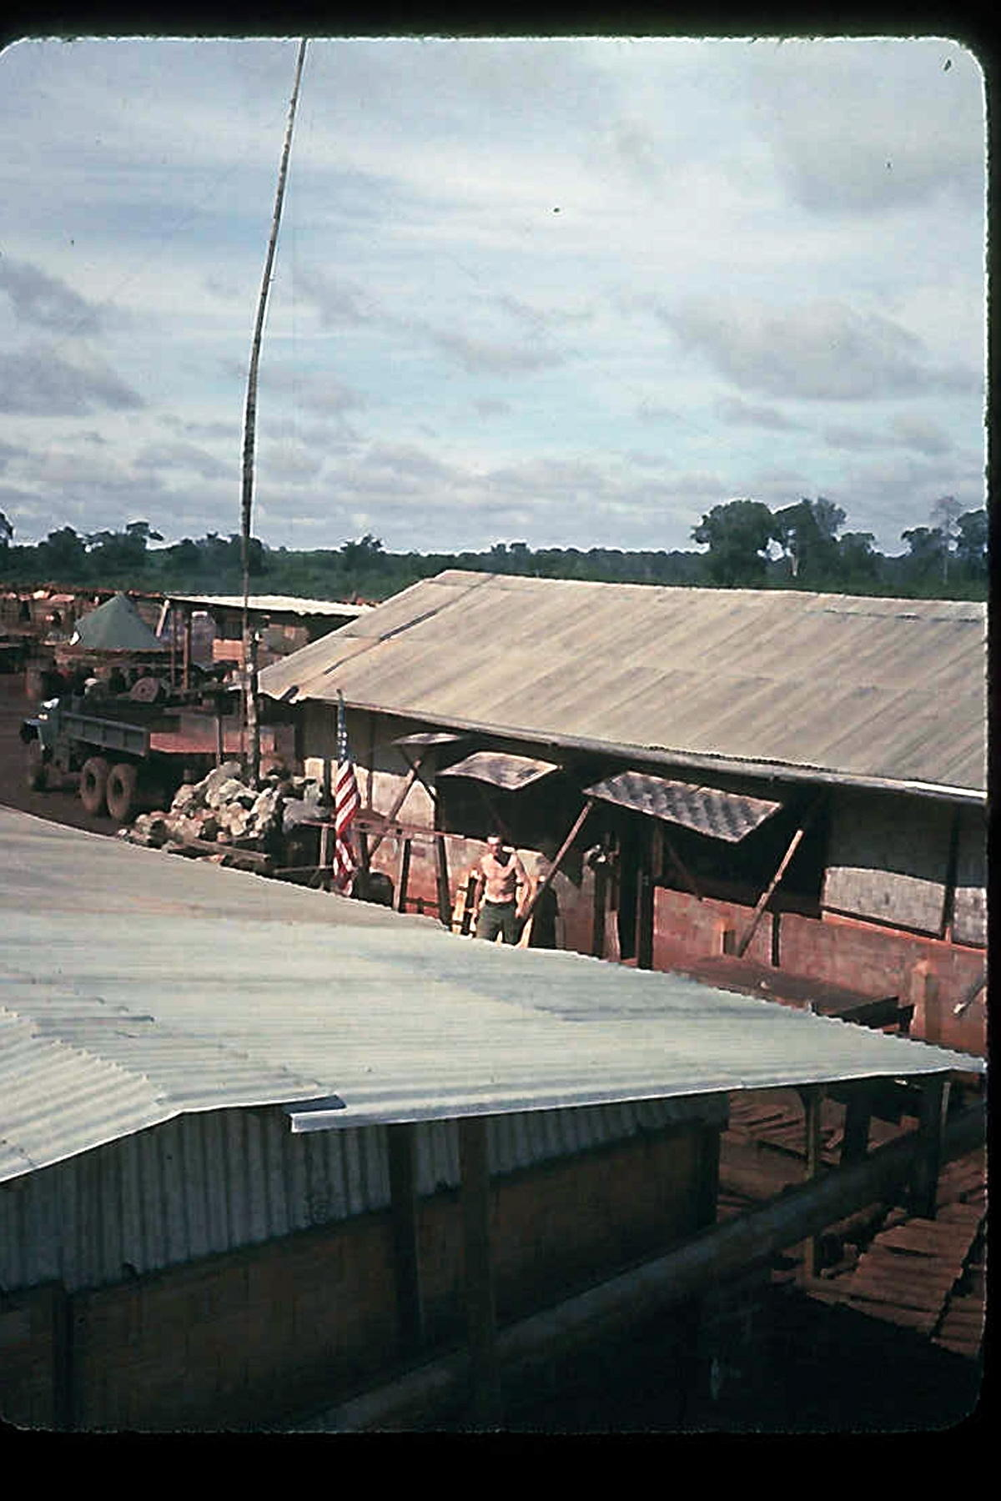
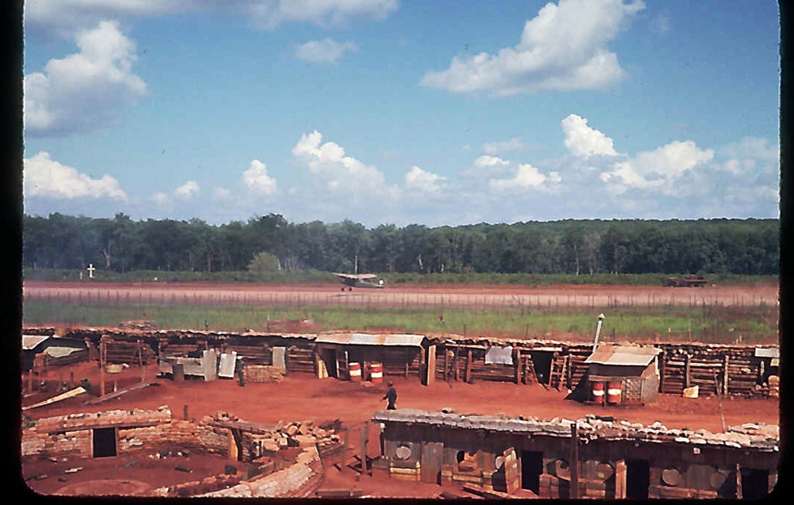
Bu Dop
A-341
Pictures Paul Posey

Slide 39
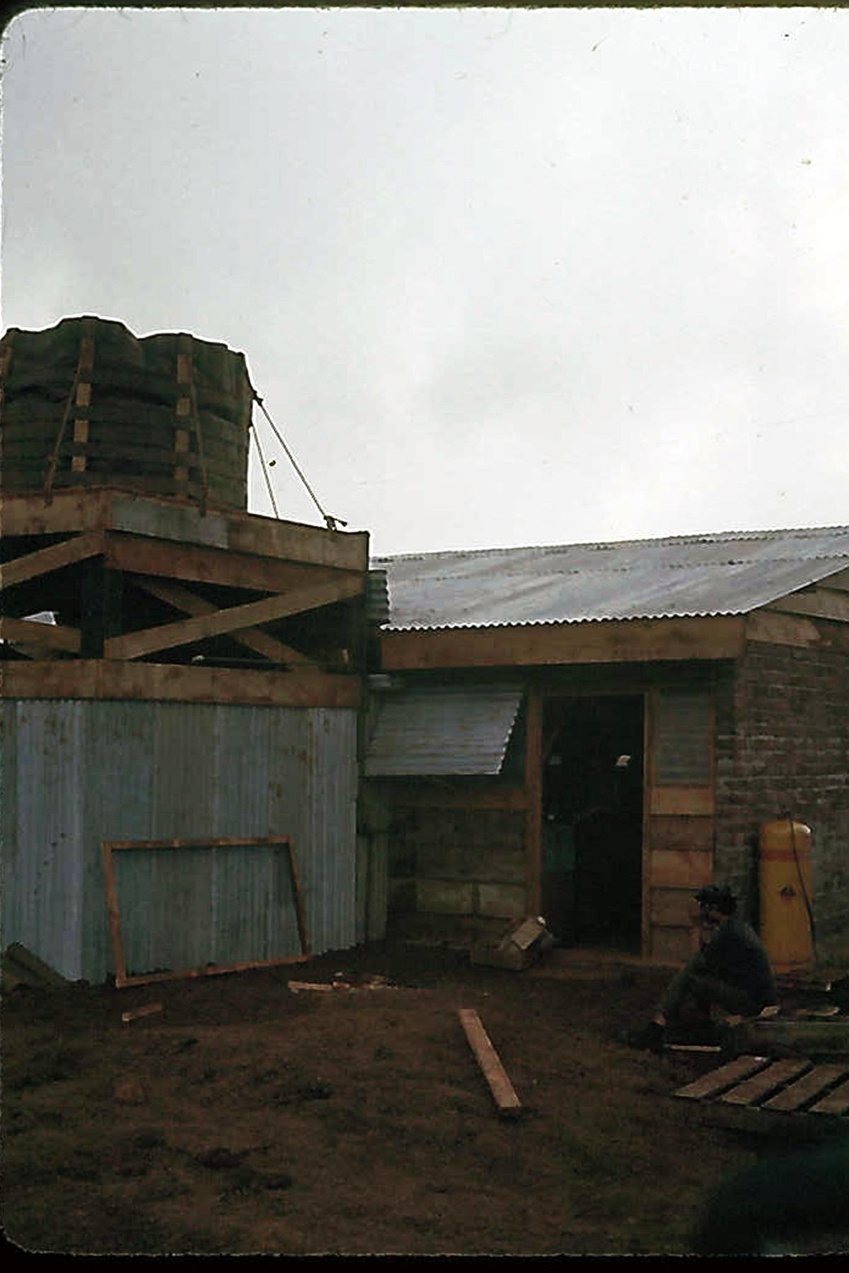
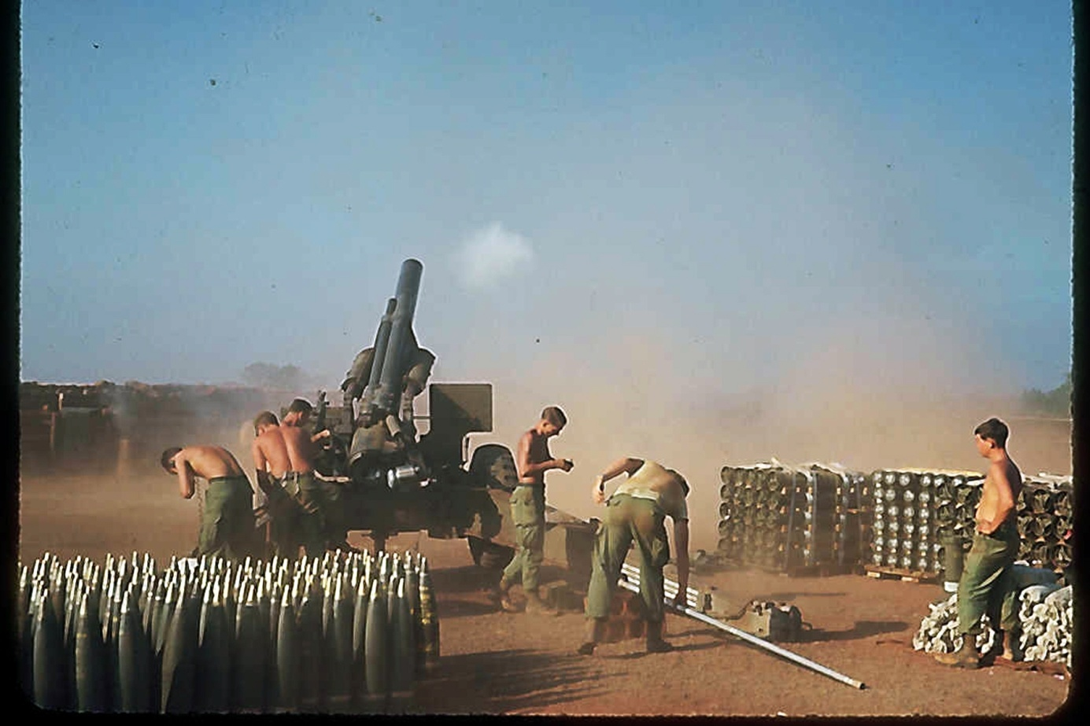
Bu Dop
A-341
Pictures Paul Posey

Slide 40
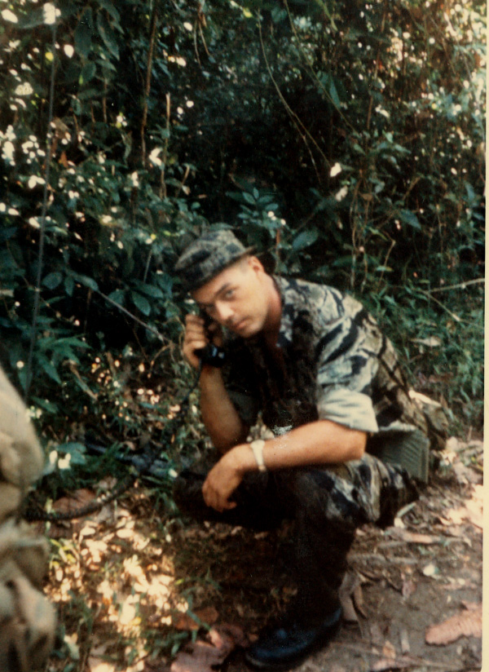
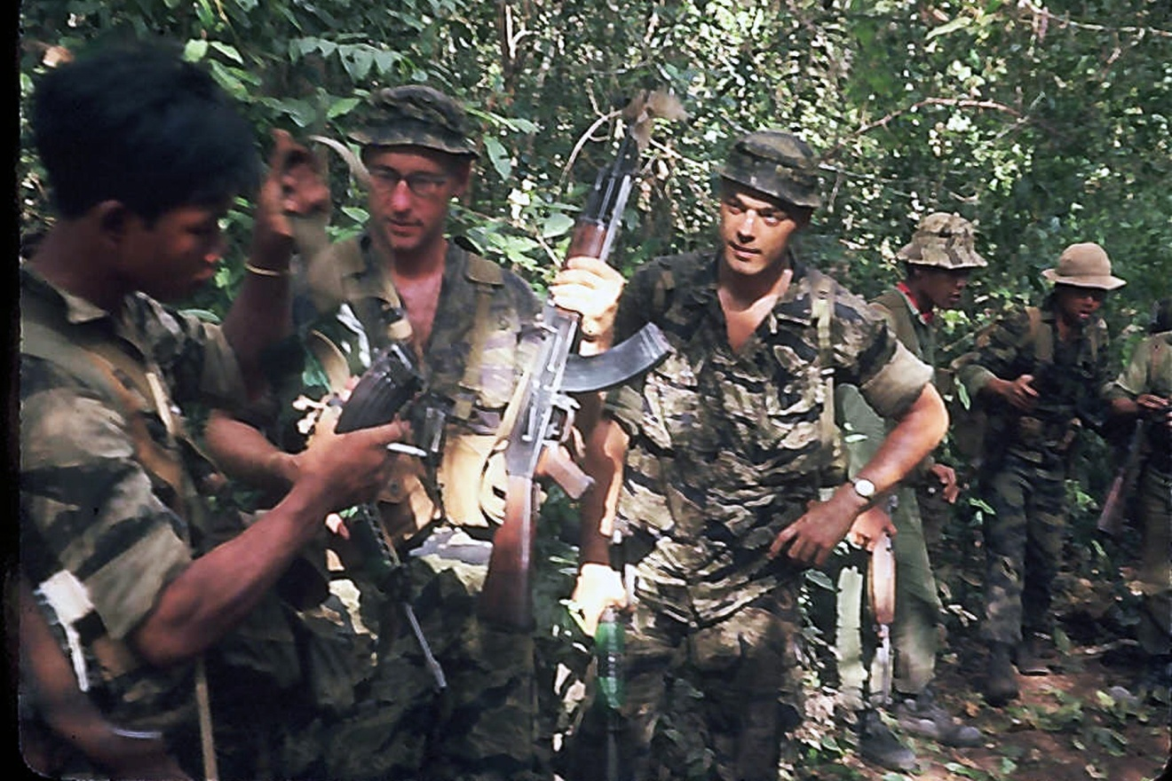
In the Jungle on Patrol
Pictures Paul Posey

Slide 41
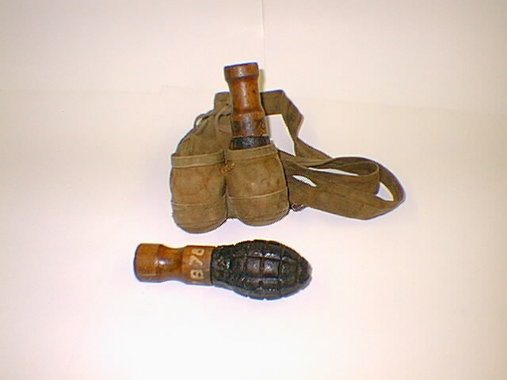
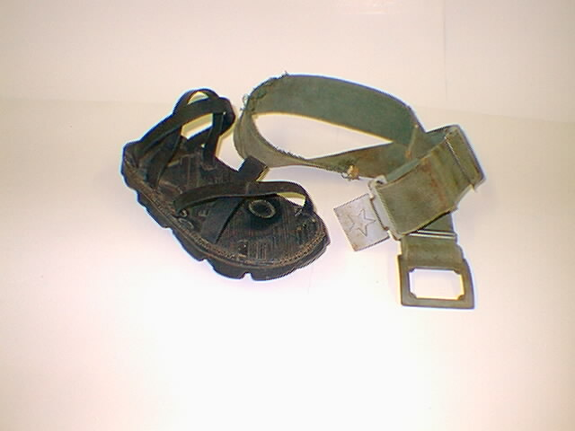
Captured
Viet Cong Equipment

Slide 42
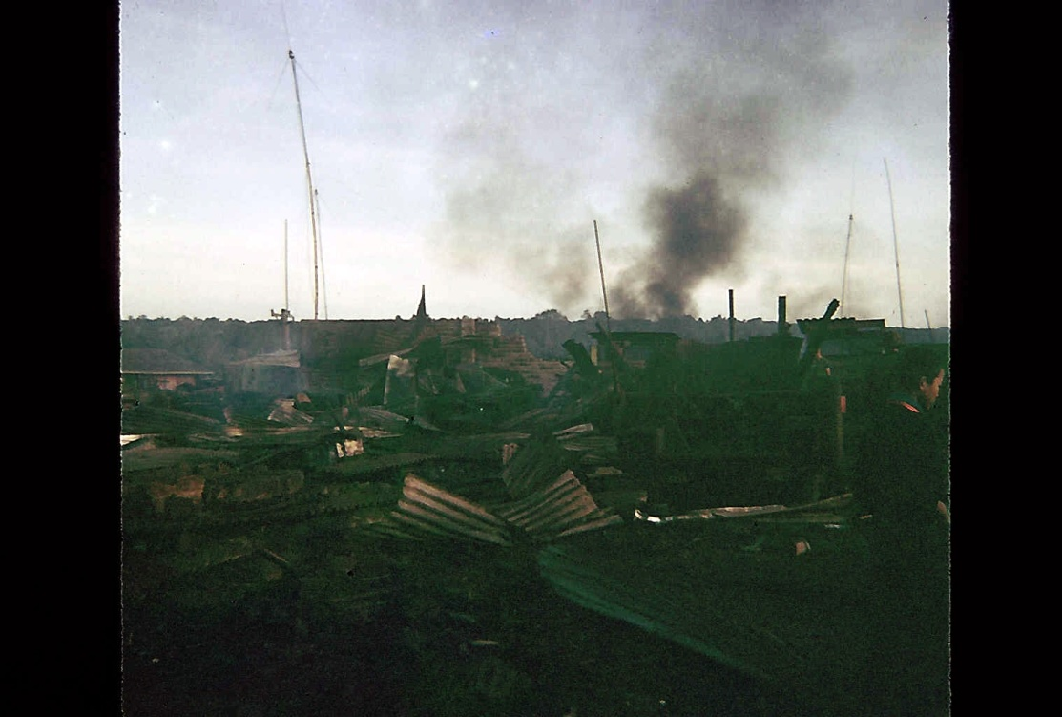
Under Attack
This is me
Picture Paul Posey

Slide 43
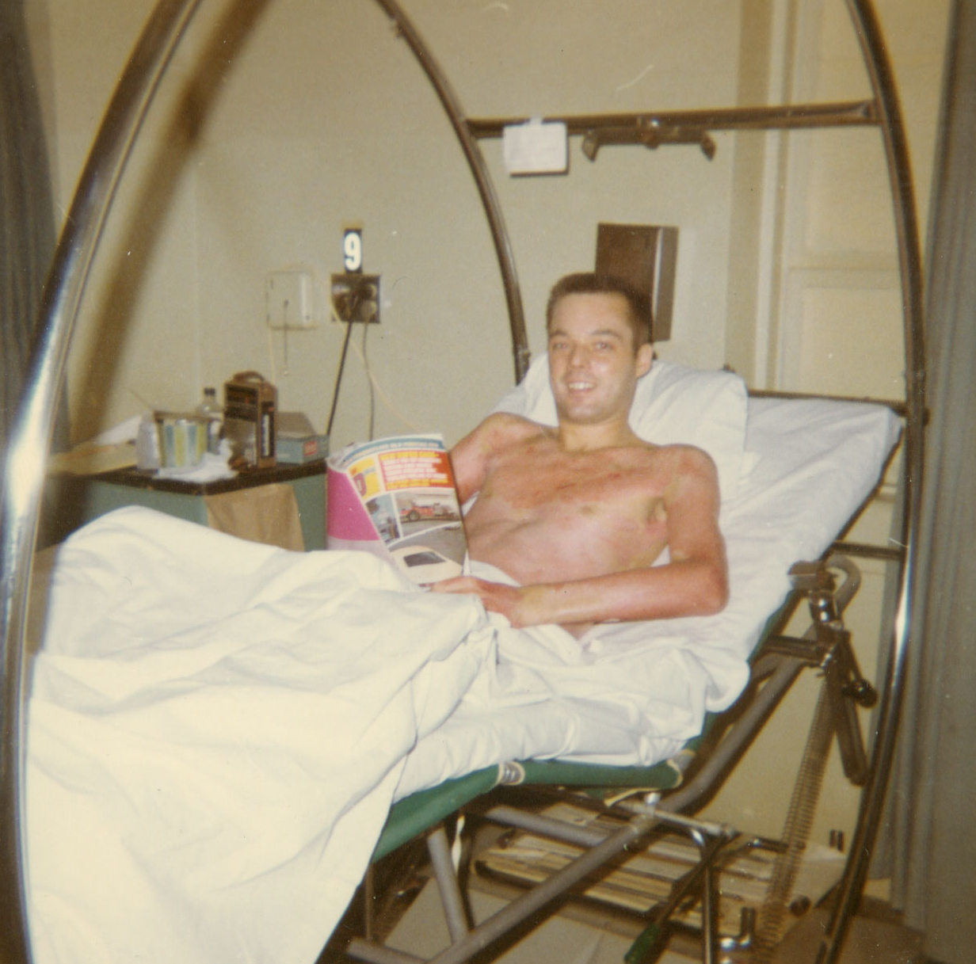
Wounded In Action (WIA)
My Dust Off

Slide 44
My Personal Battle with Death
On the night of 7/8 December 1967 I was mortally wounded (all mortal wounds don’t kill you immediately). I was medevacked and sent to a hospital in Texas where I met the grim reaper soon after arriving. He told me he was coming for me but I told him I wasn’t ready, he laughed at me and said he was going to come anyway. I told him it didn’t matter whether he came or not I just wasn't going with him. But he wasn’t to be denied and so he visited me every night in the form of a large Bengal tiger and we battled all night for the rights to my soul. He was a very vicious and determined tiger and he tried his best to rip my soul from my body with his sharp teeth and claws but I was strong and stubborn and I would not let go. This battle lasted for two months and he chewed me down to 95 pounds but in the end I prevailed and he disappeared and I was not dead and he had to settle for taking the souls of the two men who were standing next to me in Vietnam.

Slide 45
US Combat 1964 to 1973
At the beginning of 1967 public support for the war was over 50% by the end of the year it had dropped to 48%
Protests to the war were now country wide and there were many that were getting way out of control and violent, even riots, in many major cities across the country
By the end of 1967 there were 485,600 American troops in Vietnam and 11,153 more had been killed

Slide 46
Turing Point of the war Part 1
On 31 January 1968 the North launched an all out surprise assault in the South referred to now as the Tet Offensive
100 cities were attacked by 85,000 enemy troops and the battle raged for over 4 weeks.
When this battle was over 1,100 Americans and other allied troops, 2,100 ARVN Troops, 14,000 civilians, and 32,000 North Vietnamese Army (NVA) and Viet Cong soldiers lay dead
Militarily it was a major defeat for the North but the Anti-War element at home used it to show that the American military did not know what it was doing and the war had to be stopped.

Slide 47
Turing Point of the war Part 2
Peace talks start in Paris
The anti war movement was now in an all out assault to bring down the US government
1968 was also an election year and after riots in Chicago during the Democrat convention President Johnson decided not to run again and Nixon became the next President
By the end of 1968 there were 536,100 American troops in Vietnam and 16,899 more had been killed

Slide 48
Break for Questions

Slide 49
The Vietnam War 1969
Richard Nixon was now the president and his goal was to extract the troops from Vietnam and end the war on reasonable terms by getting the South Vietnamese (ARVN) to do the fighting
The Paris peace talks dragged on
15 to 18 August 1969 the Woodstock Festival was held near Bethel New York. This was a major music and war protest event
2 September 1969 Hồ Chí Minh dies
I left the service on 13 September 1969
By the end of 1969 there were 475,200 American troops in Vietnam and 11,780 more had been killed

Slide 50
Vietnam War in 1970
On 4 May 1970 at Kent State University 4 people were shot and killed by the Ohio National Guard. This followed days of campus rioting and burning down the ROTC building.
During July 1970 Team Russia & Team China split weakening the North Vietnamese cause.
During July 1970 the US 101 Airborne Division fought the NVA in the last major battle between the two enemies
By the end of 1970 public support for the war was down to 36%
By the end of 1970 there were 334,600 American troops in Vietnam and 6,173 more had been killed

Slide 51
Vietnam War in 1971
The winding down of Team USA involvement is continuing moral is generally poor and drug use is on the rise
All US offensive operations were stopped by the end of the year
Support for the war is now at 28% and no more polls were taken
By the end of 1971 there were 156,800 American troops left in Vietnam and 2,414 more had been killed

Slide 52
Vietnam War in 1972 Jan - June
In February after the North Vietnamese balked at the peace talks, again, Nixon order the heaviest air strikes of the war against the North and its forces in the South
On 21 February 1972 Nixon visited China to talk with Mao Zedong the leader of team China and reestablish relations with that country
During the spring the NVA launched an assault against the South which the US air defeated along with the ARVN troops

Slide 53
Vietnam War in 1972 July - Dec
During July Jane Fonda visited Hanoi and did very unspeakable things while there to American POW’s being held in what was called the “Hanoi Hilton”
During November and December the North was still playing games in the peace talks and so Nixon ordered more bombings
By the end of 1972 there were only 24,200 American troops left in Vietnam and only 759 more had been killed

Slide 54
Jane Fonda in Hanoi 1972
No American soldier that fought in Vietnam will ever watch a movie of hers and we think she is a traitor to our country for what she did

Slide 55
Vietnam War in 1973
On 27 January 1973 The Paris accords "Agreement on Ending the War and Restoring Peace in Vietnam“ were signed by all parties
On 12 February 1973 the North released 592 POWs but there are still many un accounted for from the war
By the end of 1973 there were only 240 American troops in Vietnam (at the US Embassy) and 168 more had been killed

Slide 56
Vietnam 1974 - 1975
Several battles were conducted by the North against the South as they became more and more aggressive during 1974 and into 1975
As 1975 started Team USA began evacuating as many Vietnamese as they could knowing the South would soon fall
Although technically funds had not been cut off yet, the North knew they would be soon as the South had lost all US and world support
On 30 April 1975 Saigon fell to the North Vietnamese army and the war was ended
By the end of 1975 there were no American troops in Vietnam and 161 more had been killed evacuating Vietnamese

Slide 57
Wrap Up USA losses
Military deaths
  47,378 military personnel were killed in combat
  10,800 military personnel died in country
  58,202 total lost in Vietnam
Wounded
  153,329 were wounded and required hospitalization
  150,375 were injured but were not hospitalized
  303,704 total wounded
Missing in Action (MIA) Prison of war (POW)
  2,338 Missing
  966 POW

Slide 58
Atrocities Committed by the North Vietnamese Army and the Viet Cong
Frequently Targeted assassinations of South Vietnamese anti-communist civilians and government/military members and their families
Frequently bombarded and machine-gunned convoys of civilians fleeing combat zones, resulting in hundreds of dead bodies on highways
Dak Son Massacre: Forced entire villages in the countryside to side with the Communists otherwise they will be killed, for example they massacred the entire village of Dak Son, 300+ people,
Hue Massacre: Massacred 5,000 people in Hue during their one month occupation of the city in Feb 1968, and then destroyed the Hue Massacre Memorial after 1975 invasion.

Slide 59
Total Accounting 1955 to 1975
Team USA, RVN plus allies
  About 650,000 killed
  About 1,490,000 wounded
Team Russia, North Vietnam, China and North Korea
  About 820,000 killed
  About 608,200 wounded
Grand total
  About 1,470,000 killed
  About 2,098,200 wounded

Slide 60
Break for Questions

Slide 61
Post 1975 Cambodia
Cambodian Civil war 11 March 1967 to 17 April 1975 won by the Khmer Rouge (Communists) creating the Democratic Kampuchea
The Khmer Rouge from 1975 to 1979 lead by Pol Pot and his gang of Communists started a reign of terror that killed between 1.4 and 2.5 million people which was called the Killing Fields
After several attempts at stopping Pol Pot the Vietnamese invaded in December 1978 and took out the Khmer Rouge and Pol Pot and his supporters escaped into the mountains of Thailand

Slide 62
Post 1975 Indochina
After the Communists took over all of the former Indochina countries Vietnam, Laos and Cambodia there was a huge migration out of the area mostly from Vietnam that lasted from 1975 to 1995
There were 1,642,179 Vietnamese refuges many of them escaped by boat and they were called “boat people” where many thousands were lost at sea
The total number of refuges that left the area is estimated at 2,547,170 and about half ended up in the US at 1,287,399

Slide 63
Post 1975 America
When veterans came home they were not treated well, in fact they were often treated very badly
Many veterans had serious problems because the country didn’t like them
Veterans learned to never even admit that had been in Vietnam. In job interviews we were even asked if we were mentally stable
This derogation went on for us until after the first Gulf War, Operation Desert Storm in 1991

Slide 64
Post Traumatic Stress Disorder
The term “Posttraumatic Stress Disorder" or PTSD came into use in the late 1970s in large part due to the much larger number of US military veterans of the Vietnam War that had mental problems then in past conflicts
PTSD was very common in Vietnam Vets both because of the war itself and the treatment they got when they got home
In most past conflicts and wars the troops coming back were treated well and so being treated as criminals was extra painful

Slide 65
World Embarrassment
From 1945 to 1985 Indochina was a nightmare
  4,388,907 Estimated Killed
  2,157,671 Estimated wounded: Note One
  2,547,170 Displaced by war: Note Two
  9,093,748 TOTAL
The world ignored this as there had been no good reason for this to happen the way it played out
Notes:
  One, because of the poor accounting during this period this number was probably much higher
  Two, Thousands maybe tens of thousands were lost at sea and there is no accounting of them

Slide 66
Causes for the War
There were three causes for what happened
  One FDR agreed to allow France to reoccupy Indochina at Yalta but died before the war ended and President Truman didn’t change the agreement
    If France had not gone back in probably none of this would have happened
  Two the Johnson administration going to war
    If Johnson had not gone to war the south would have fallen quickly and losses would have been small
    If Johnson had gone in fast and hard the north would have fallen and the losses medium (the best option)
  Three the Boomer Generation being self centered
    If Baby Boomers would not have been so self centered they might not have driven the world to abandon Indochina and losses would have been a lost less

Slide 67
Why you don’t know
So the reason you know so little about what happened back then is that everyone in the governments across the entire world (many of them the protestors back then) knew that they screwed up and cost almost 5,000,000 people their lives plus 3,000,000 people were injured and another 3,000,000 or more forced to flee the area to get away from the killing.
The social scars for this are still with us today and will be for generations to come.

Slide 68
The End of Team Russia
Team Russia was the Union of Soviet Socialist Republics or the U.S.S.R. and was the driving force for expanding the views of Communism
On 26 December 1991 Russia gave up and dissolved the U.S.S.R. and in its place we had the Russian Federation and 14 other countries.
The U.S.S.R. failed because it could not compete economically with the United States and Europe
This proved that Communism doesn’t work

Slide 69
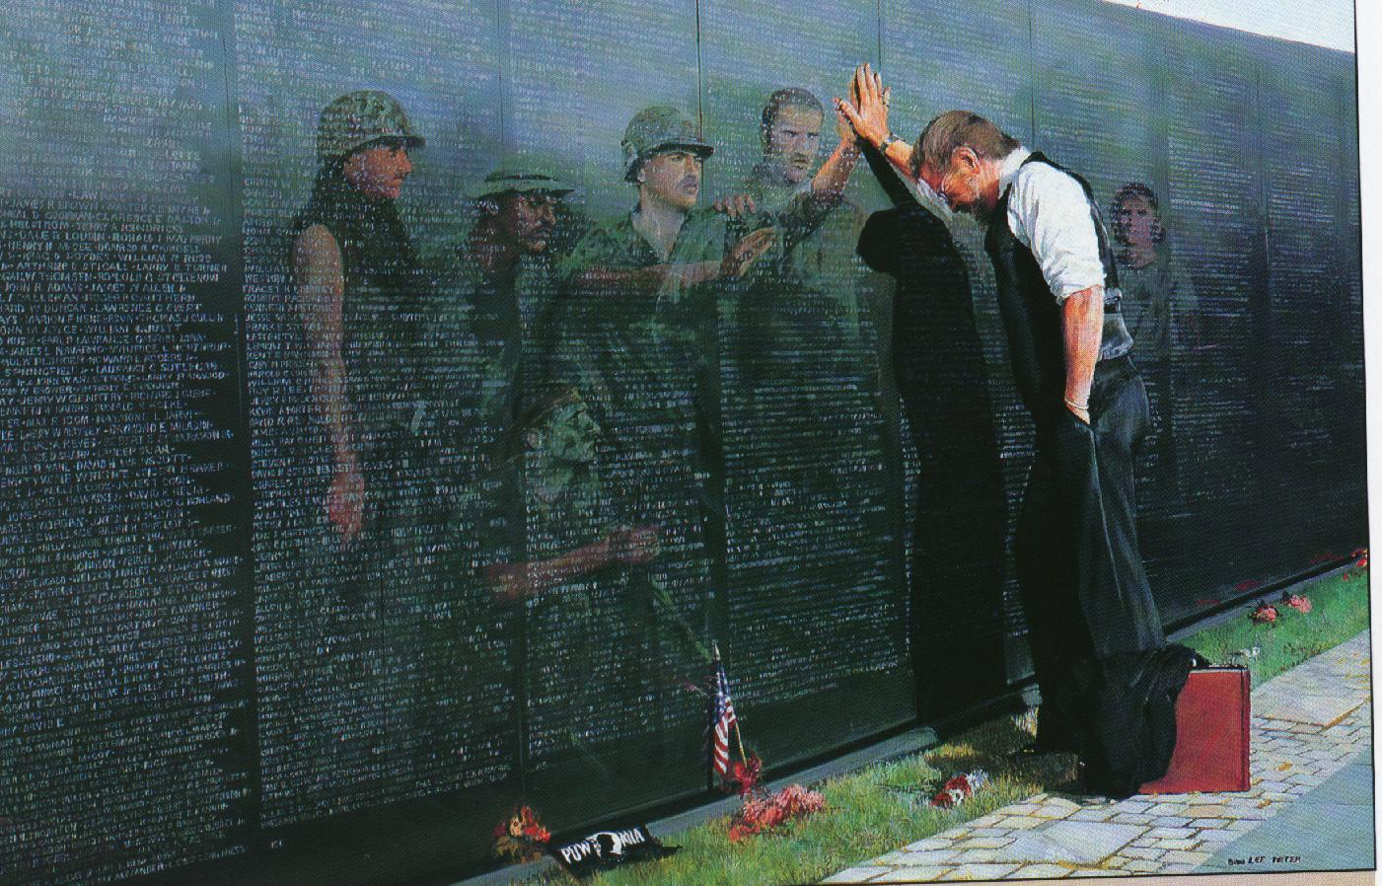
Vietnam Wall 1982

Slide 70
Special Forces casualties resulting from operations conducted at or around 5th SF Group (Abn) camp Bu Dop A-341 October through December 1967
Name KIA/WIA Died The Wall
MAJ John O. Cooper, III KIA 26 October 1967 Panel 28E, Line 73
SP5 Joseph R. Beck, Jr. KIA 26 October 1967 Panel 28E, Line 72
SFC Elmer R. L. Ables, Jr. KIA 26 October 1967 Panel 28E, Line 71
MSG James O. White WIA 28 November 1967
SFC Herman A. McBride KIA 29 November 1967 Panel 31E, Line 6
SGT Michal Millner MIA 29 November 1967 2 July 1974 Panel 31E, Line 005
SP4 Paul Posey WIA 1 December 1967
SP4 Jerry D. Schroeder WIA 8 December 1967 3 January 1968 Panel 33E, Line 32
MSG Ernest O. Broom WIA 8 December 1967 11 January 1968 Panel 34E, Line 27
1 LT David J Pristash WIA 8 December 1967

Slide 71

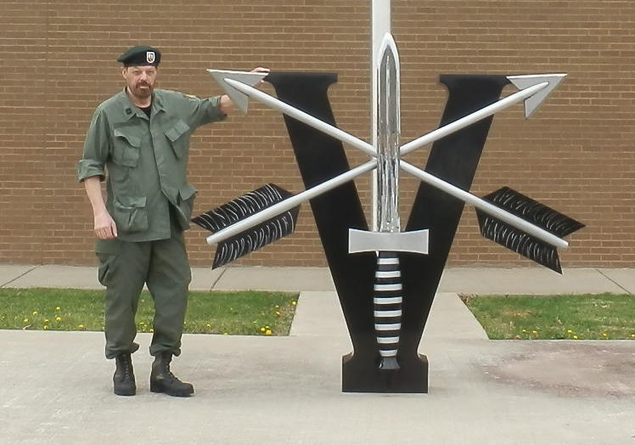
Ft Campbell March 23, 2016

Slide 72
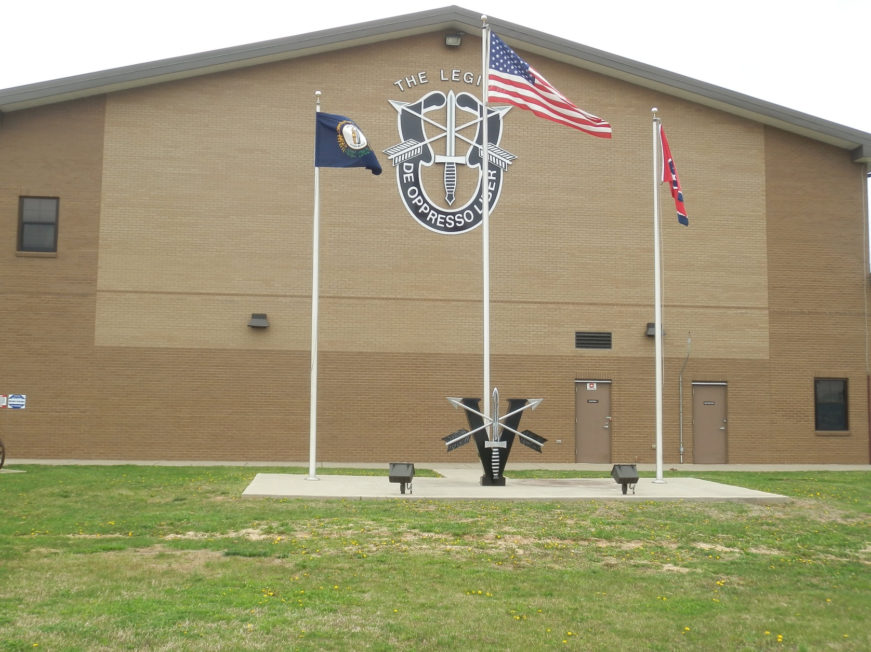
5th Special Forces Group Airborne

Slide 73
Break for Questions

Slide 74
Recommended Reading
Halberstam, David, The Best and the Brightest, New York: Radom House, 1972, ISBN 0-449-90870-4
Chau, Tran Ngau, & Fermoye, Ken, “Vietnam Labyrinth,” Lubbock Texas: Texas Tech University Press, 2012, ISBN 978-0-89672-771-7
Friedman, Milton & Rose Friedman, Free To Choose, New York: Harcourt Brace & Company, 1990, ISBN 0-15-633460-7 (pbk.)
Strauss, William and Neil Howe, The Fourth Turning An American Prophecy New York: Broadway Books, 1997, ISBN 978-0-767900-46-1.

Slide 75
Recommended Reading
Skousen, W. Cleon, The Five Thousand Year Leap, 28 Great Ideas That Changed the World, Franklin: American Documents Publishing, 2009, ISBN 978-0-9815596-6-7
Codevilla, Angelo M., The Ruling Class, How they Corrupted America and What We can do About it, New York: Beaufort Books, 2010, ISBN 978-0-8253-0558-0 (alk. paper)
De Tocqueville, Alexis, Democracy in America, Volume 1 and 2, translated by Gerald E. Bevan introduction by Isaac Kramnick, London: Penguin Books, 2003, ISBN 978-0-14-044760-6

